Slide 1
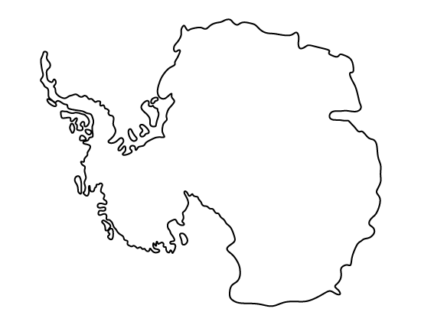
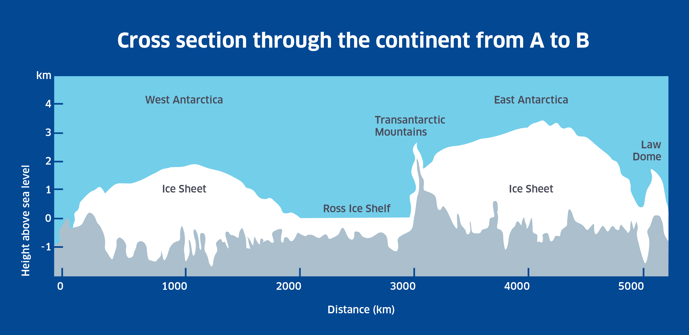
ANSWER KEY
Name:_________________________________________ Date:_____________________
Exploring Antarctica and the Southern Ocean
Add the following to the map:
Southern Ocean
Antarctic Circumpolar Current
Sub-Antarctic Front
Polar Front
Weddell Gyre
Weddell Sea
Ross Gyre
Ross Sea
Bellingshausen Sea
Amundsen Sea
East Antarctica
West Antarctica
Antarctic Peninsula
Approximate locations of the Atlantic Ocean, Pacific Ocean, and Indian Ocean
>
Atlantic Ocean
Current
Circumpolar
>
Antarctic
>
Indian Ocean
Weddell Sea
>
>
>
Antarctic Peninsula
>
Bellingshausen Sea
>
West Antarctica
East Antarctica
Amundsen Sea
>
Ross Sea
>
Pacific Ocean
>
>
>
>
Southern Ocean
What would a cross section throughout Antarctica from point A to point B look like? Draw it below. Make sure to include:
East Antarctic Ice Sheet
West Antarctic Ice Sheet
Ross Ice Shelf
Transantarctic Mountains
Law Dome
A
Ice Sheets (2)
X-axis
Y-axis
Units
B
https://discoveringantarctica.org.uk/wp-content/uploads/2015/11/DA-diags_D_a_1.4_continent_cross_section_ab.png
Notes:
Reference Maps for Answers:
Antarctic Circumpolar Current, Sub-Antarctic Front, Polar Front, Weddell Gyre, & Ross Gyre
http://www.antarctica.gov.au/__data/assets/image/0009/170289/varieties/antarctic.png
Weddell Sea, Ross Sea, Bellinghausen Sea, Amundsen Sea, Pacific Ocean, & Indian Ocean
https://earthobservatory.nasa.gov/Features/SeaIce/images/antarctica_map.png
Atlantic Ocean
https://cdn.britannica.com/93/126593-004-045633EB.jpg
East Antarctica, West Antarctica, & Antarctic Peninsula
https://images.labroots.com/content_article_profile_image_093096c84861d454590c8cb6306852c9b111a7c2_1115.jpg
Reference for Cross Section from A to B:
https://discoveringantarctica.org.uk/oceans-atmosphere-landscape/ice-land-and-sea/ice-sheets-and-glaciation/

